Slide 1


Dept of ECE

Slide 2
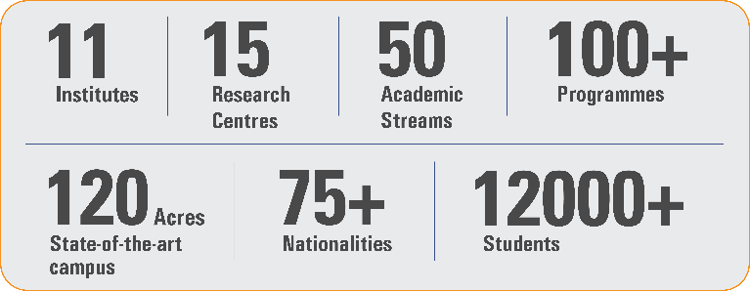
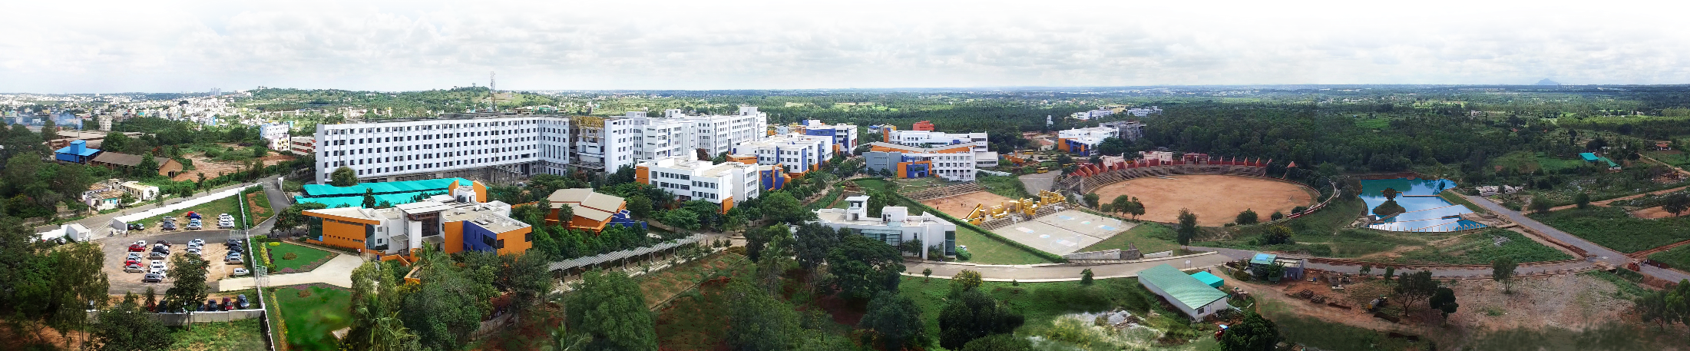
Overveiw
Acharya stands as a beacon of excellence in higher education, boasting a legacy of academic distinction since its establishment in 1990. We offer a transformative educational experience, fostering holistic development, nurturing innovation and providing world-class facilities to ensure an enriching journey for our students.
Dept of ECE

Slide 3
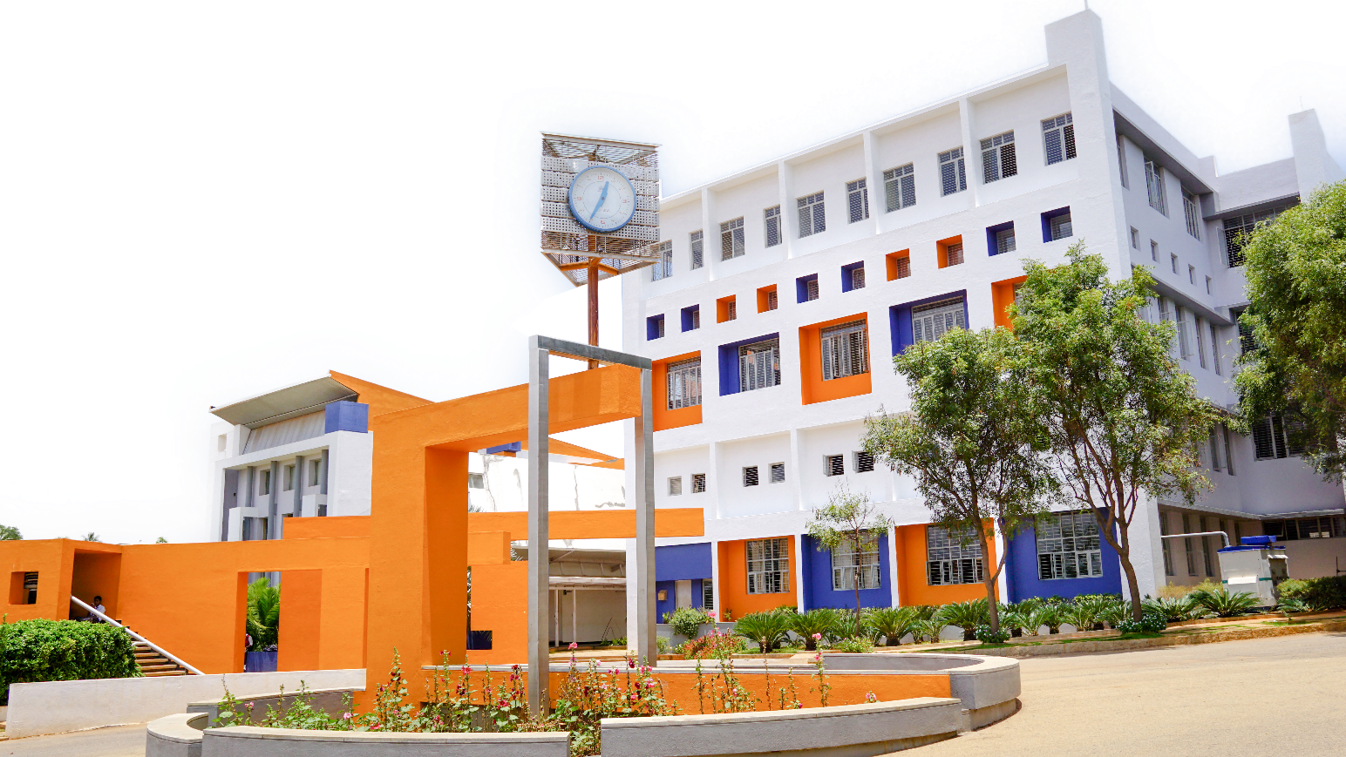
11 Institutions, Infinite Possibilities
We provide 100+ programs across 50 academic streams.
Dept of ECE

